Slide 1
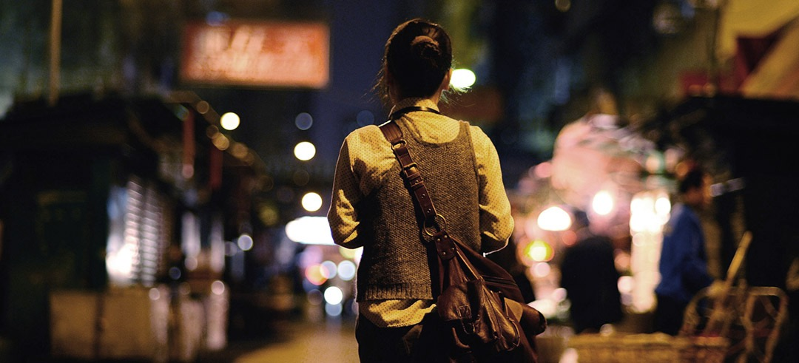


Can Smartphones keep us safe ?
Pragyan Mishra | getsafely.net
#GHC
18

Slide 2
45% of Women feel unsafe to walk alone at night.

Slide 3
How people feel about physical safety has a direct impact on exercise.
Research from the National Institute of Health (NIH)

Slide 4
Smartphones know a lot!
Where we parked.
How much we walk, run.
Where we live, work, eat, sleep.
4

Slide 5
Smartphones know a lot!
And they use this to show us
ADs
5

Slide 6
Can smartphones be our assistant for our safety and wellbeing ?

Slide 7
Teenager stuck in car, Siri could not help
Used Siri to place 911 call.
Last words were to Siri.
7

Slide 8
Where is the technology at right now and what is the gap for making this vision a reality ?

Slide 9
USER safety
SMARTPHONES
AI/DEEP LEARNING
USER ACTIVITY
LOCATION DATA
SOCIAL DATA

Slide 10
Privacy Considerations
In order to access user location:
Data processing happens on the SensorHub / DSP on the phone.
Federated learning is used to update models on the phone. Learning specific to the user happens on the phone.
Social data/contacts, possibly incident data stored in the cloud.
GDPR compliance. (General Data Protection Regulation)
10

Slide 11


PLATFORM CONSIDERATIONS
Android Service
Background Mode
Android Sensor Hub
Core Motion Framework
11

Slide 12
Sensor Hub
2 Billion units expected to be shipped in 2018
Allow low-power processing of sensor data.
iPhone 6S line in 2015 was the first large scale platform.
Used for:
Voice-based AI.
Fitness data processing (step count, miles walked, driven, etc).
Possible to repurpose for:
Deep learning networks to determine anomalous patterns.
Location tracking, walk/run patterns.
Always-on inferencing.
12

Slide 13

Safely
PERSONAL SAFETY
AI
MACHINE LEARNING
ANDROID SENSOR HUB
13

Slide 14
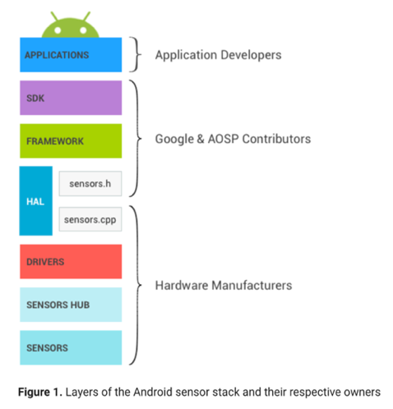



DESIGN CONSIDERATIONS
Safely
Android Sensor Stack
14

Slide 15
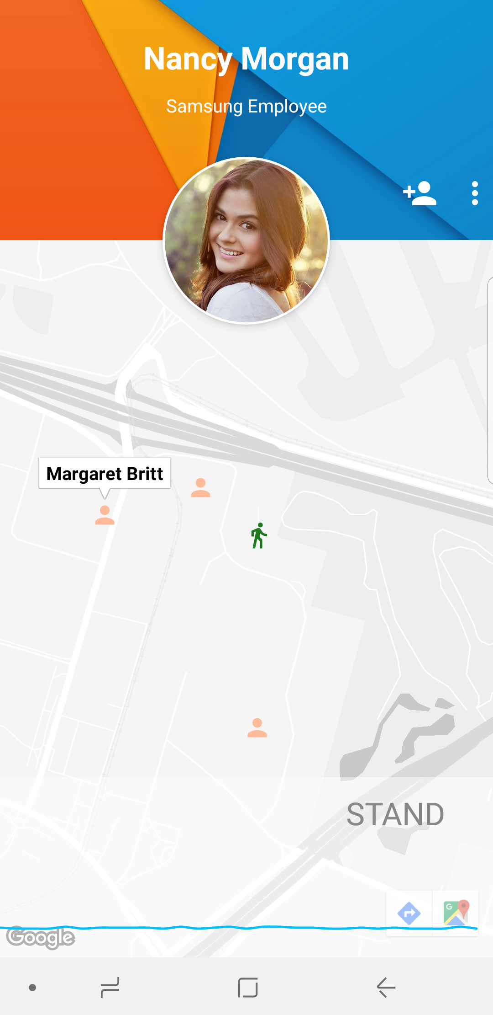
Safely
REALTIME TRACKING :
USER
+
COWORKERS NEARBY
Nancy Morgan
SENSOR DATA
+
MACHINE LEARNING
15

Slide 16
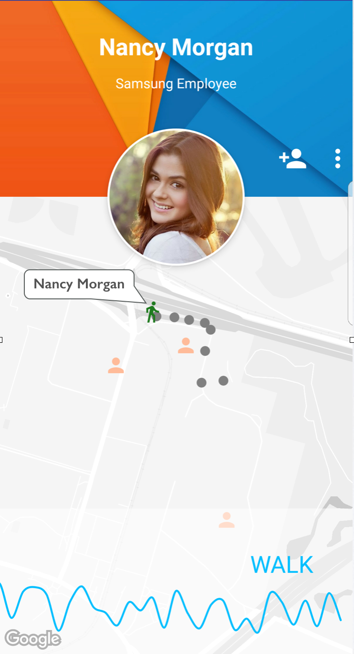
Safely
USER WALKS TO PARKING
+
COWORKERS NEARBY
SENSOR DATA
+
MACHINE LEARNING
16

Slide 17
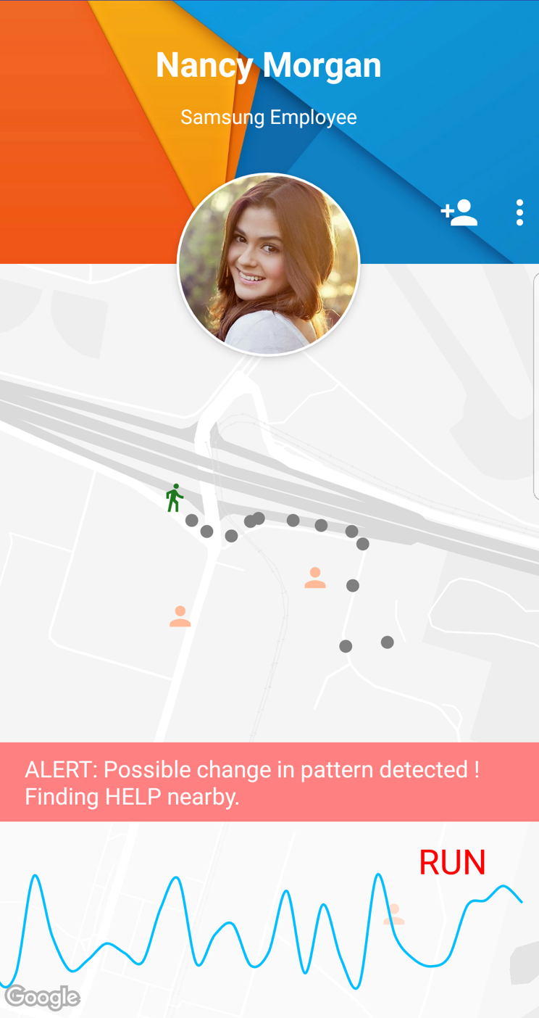
Safely
ALERT SENT TO :
CAMPUS SECURITY
+
NEARBY COWORKERS FOR HELP
ANAMOLOUS PATTERN
DETECTED
17

Slide 18
18

Slide 19


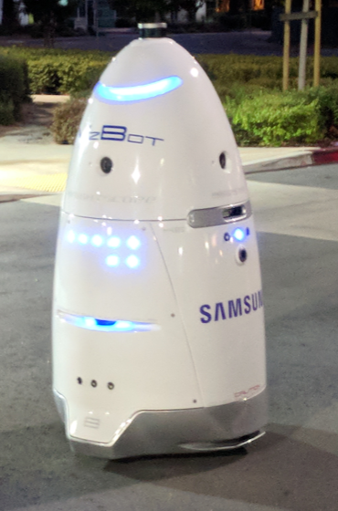


Safely
Sensor hub
Smotion API
security
coworkers nearby
19

Slide 20
Safely
Platform: Hike example
Management layer: Hiking event gets registered.
Custom hike module gets installed and activated on Safely.
Features:
If the hiker is not reachable, the system calls the local park rangers.
Current location of all hikers in a group can be shared.
p2p network is maintained among hikers to extend connectivity to cellular network.
20

Slide 21
Safely
as a Platform
Campus security network
Social safety groups
Event
safety
Management layer
3rd party module
3rd party module
3rd party module
Public safety networks: e-911
Base AI Model
(OEM controlled)
Disaster Recovery
P2P network layer
21

Slide 22
Call to action (iOS/Android)
Enable programmatic access to low power Sensor hub.
Expose triggers for app developers.
Have a notion of a “safety platform provider”. Users can download/register apps.
Support a vibrant 3rd party app ecosystem.
Expose enterprise APIs for the platform.
22

Slide 23
Safely
to the rescue
Detect any anomalous pattern.
Hibernate into low power mode to save battery.
Proactively contact authorities.
23

Slide 24
Safely
Always on Safety Assistant.
24

Slide 25
Can Smartphones keep us safe ?
Pragyan Mishra | getsafely.net
#GHC
18
Questions ?

